Slide 1
Bayesian A/B Testing

Slide 2
Overview
Purpose A key component product development is innovation, and the cornerstone of innovation is experimentation. The purpose of this presentation is to argue for changing the experimentation framework from traditional A/B testing to Bayesian. What that means and why we should make this change are discussed.

Slide 3
tl;dr
Traditional vs. Bayesian A/B testing
Traditional A/B Testing
Does not answers the question, “what is the probability that A > B?”
Requires larger samples
Unlikely to detect incremental lifts
Wastes money
Often inconclusive
Bayesian
Answers the question, “what is the probability that A > B?”
Can quantify risk with smaller lifts and smaller sample
Minimizes wasted spend
Flexible when deciding when to end an experiment and declaring a winner

Slide 4

Problem Statement

Slide 5





Experimentation Context
INCREMENTAL IMPROVEMENT
PACE OF INNOVATION
TIGHT BUDGET
QUESTION TO ANSWER
New products and/or user experience create lifts on the order 1-3%, not 5%+
Need to iterate in weeks, not months
Need to optimize our experimentation spend
What’s the probability that A is better than B?

Slide 6
Traditional A/B Testing

Slide 7
False Positives
Stat Sig (money)
The point of achieving statistical significance is to avoid identifying a difference that doesn’t exist
These types of errors generally have little consequence for the business, e.g., margin.
If the difference between the variants is large, then this approach is wasteful as we continue to invest money in an inferior strategy
If the difference between the variants is small, it doesn’t matter much which one we use
Failing to reach significance provides no direction to the business

Slide 8
False Negatives
Sample size (time)
The ability to quickly iterate on experiments and continually improve product depends on traffic
Either approach works well with lots of traffic, but Bayesian works much better for conversion rates that are farther down the customer funnel

Slide 9
Traditional A/B Testing
Too conservative and rigid
Error Rates
Traditional A/B testing is focused on error rates, not on making the best decision for the business
False negatives
False positives
Traditional A/B testing assumes that a false positive is four times as costly as a false negative, which is why p = .05 is the standard significance level
Stat sig
Traditional A/B testing treats experiments like they’re black and white: if you reach stat sig you roll, otherwise you don’t. This approach treats stat sig results as “real’, and anything else as not real.
Inconclusive Results
Failing to reach statistical significance is an inconclusive result - it doesn’t mean that the variant isn’t an improvement, it just says that we don’t have enough evidence to say it is at a particular significance level
Null hypothesis: A = B
Alternative hypothesis: A < B
We either :
reject the null hypothesis (stat sig), or
“fail to reject” the null hypothesis, meaning we don’t have enough evidence to reject it.
We never “accept” the null hypothesis.

Slide 10

Traditional A/B Testing
When it doesn’t work
Incremental Improvement
Small lifts require a large sample to detect
Pace of Innovation
Large samples can take months to collect
Tight Budget
While running the experiment for months, money is being spent on an inferior variant
Question to answer
“What is the probability that variant A is better than variant B?”
Traditional A/B testing says:
“Assume there is no difference between the variants. The probability of seeing this lift (or more extreme) is x% (whatever the significance level is).”

Slide 11
Bayesian Approach
The new kid on the block

Slide 12

Explore/Exploit Dilemma
Playing Slot Machines
Imagine there are two slot machines that pay out at different rates, How would you determine how to maximize your payout?
Explore
You need to play both machines a certain number of times in order to answer this question
Exploit
You need to play the machine with the better rate to maximize your payout
Dilemma
How much do you exploit the current best rate vs. explore the other slot machine to gain confidence about which machine has the better payout rate?
Notes:
Also known as one-arm bandits

Slide 13
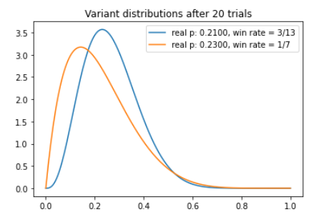
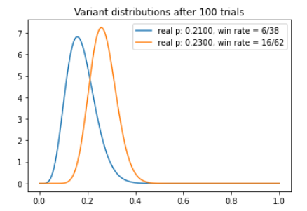
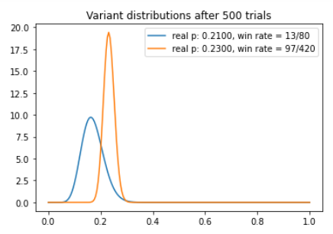
Simulating an Experiment
with Bayesian sampling
The algorithm chooses the variant with the better success rate, while continuing to explore the other variant

Slide 14
Bayesian A/B Testing
No need for:
Determining:
Meaningful effect size
Sample size
Statistical Significance
Control
Avoiding peeking or ending the test early
Strict rules/terminology about interpreting results, i.e, fail to reject the null hypothesis vs. accept the null hypothesis
Rather we can answer: what is the probability that A > B?
Avoiding multiple metrics/KPI’s
Lends itself to testing multiple variants simultaneously, i.e, A/B/C tests
More amenable to small samples

Slide 15
When does the experiment end?
If we don’t have a set sample size
1
2
3
Regular Traffic
There is active daily traffic with respect to the primary success metric
Minimum of Two Weeks
It is recommended that the experiment run for a minimum of two weeks to account for weekly periodicity
Probability of Being Best
At any point in the experiment we can use the results estimate the probability of one variant being the best

Slide 16
Experiment Power Analysis
Traditional A/B Testing
Assuming:
Control: 21% conversion rate
Test: 23% conversion rate
Confidence | Approved apps needed in each condition | Total Sample | Weeks to collect
99% (p = .01) | 4658 | 9316 | 46 (10.5 months)
95% (p = .05) | 2336 | 4672 | 23 (6 months)
90% (p = .10) | 1406 | 2812 | 14 (3.5 months)
80% (p = .20) | 620 | 1240 | 6 (1.5 months)
Notes:
Assumes 200 samples per week

Slide 17
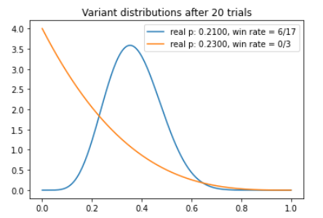
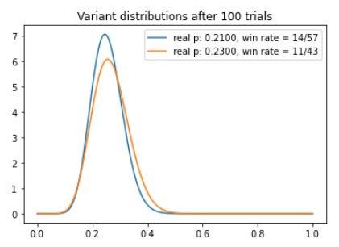
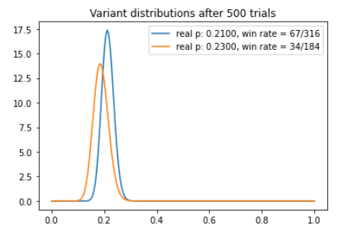
Simulating the Experiment
Bayesian Sampling
Simulating the experiment using random sampling from each distribution means that sometimes the inferior variant will “win”.
How often will depend on how big the difference is between the true means, and how many trials we’ve run. As the number of trials increases, the algorithm will self-correct.
This mimics how experiments work in real life and allows us to estimate the sample size needed for an estimated lift
“Running” this experiment 10,000 times we find that the superior variant is the “winner” 68.5% of the time
Because the algorithm is self correcting, we expect that with more trials (>500), the probability of the superior variant coming out on top will improve

Slide 18
Experiment Simulation
Bayesian A/B Testing
Assuming:
Control: 21% conversion rate
Test: 23% conversion rate
Approved Apps | Probability of Superior Variant Winning | Weeks to Collect
 | 10,000 Simulations
500 | 68.5% | 2.5
600 | 70.8% | 3
700 | 71.7% | 3.5
800 | 73.9% | 4
900 | 74.3% | 4.5
1000 | 76.0% | 5
Notes:
Assumes 200 samples per week

Slide 19
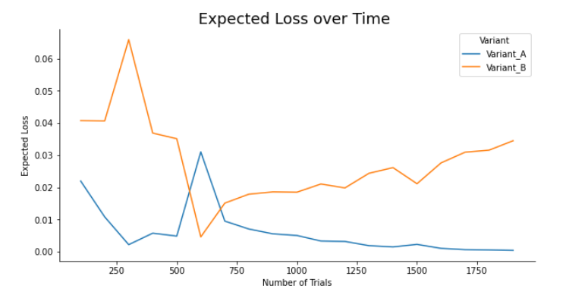
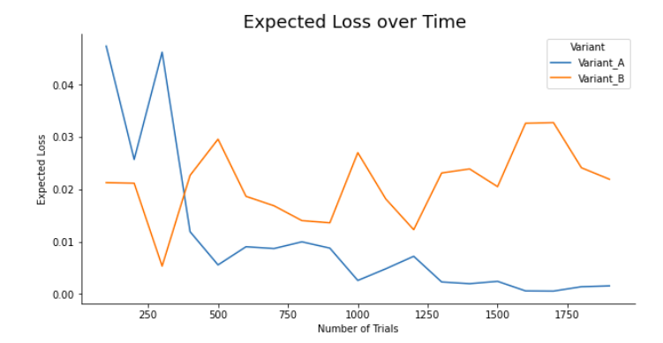
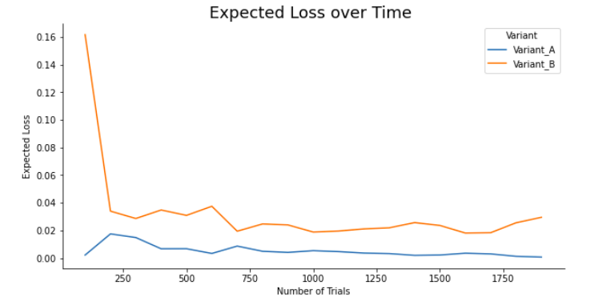
Simulating an Experiment
Stopping metric: Expected Loss
In addition to “Probability to be the best”, another metric we can use to guide decision making regarding when to end an experiment is expected loss
Expected loss looks at the cost of choosing a one variant at any point in the experiment and estimating what we might expect to lose by doing so
Probability to be the best estimates the reward with choosing a variant
Expected loss estimates the risk

Slide 20
Some References
https://towardsdatascience.com/a-b-testing-is-there-a-better-way-an-exploration-of-multi-armed-bandits-98ca927b357d
https://static.googleusercontent.com/media/research.google.com/en//pubs/archive/42550.pdf
https://launchdarkly.com/blog/alternative-to-statistical-significance-making-decisions-with-experiments/
https://www.udemy.com/course/bayesian-machine-learning-in-python-ab-testing/learn/lecture/21794012#overview
https://towardsdatascience.com/how-to-analyse-a-b-experiments-using-bayesian-expected-loss-b959e21a77ce
https://www.chrisstucchio.com/blog/2014/bayesian_ab_decision_rule.html
https://medium.com/convoy-tech/the-power-of-bayesian-a-b-testing-f859d2219d5
http://varianceexplained.org/r/bayesian-ab-testing/
https://towardsdatascience.com/why-statistical-significance-is-ruining-your-ab-tests-8f1f33d7810a
https://web.archive.org/web/20100929074846/http://sirevanhaas.com/?p=30
https://towardsdatascience.com/what-comics-can-teach-us-a-b-experiment-analysis-c1ba70e50d0c
https://medium.com/towards-data-science/python-package-for-bayesian-a-b-testing-86ea3ff5c963
https://towardsdatascience.com/bayesian-a-b-testing-with-python-the-easy-guide-d638f89e0b8a

